Slide 1
The Currency of Data Science: A Deep Dive into Salaries
Data Wizards

Slide 2


Patrick, a Business Analytics graduate, aims for a data science career despite no prior experience.
He explores diverse opportunities worldwide and prioritizes understanding salary trends and job prospects to make informed career decisions.
His determination drives him to navigate this landscape effectively.

Slide 3
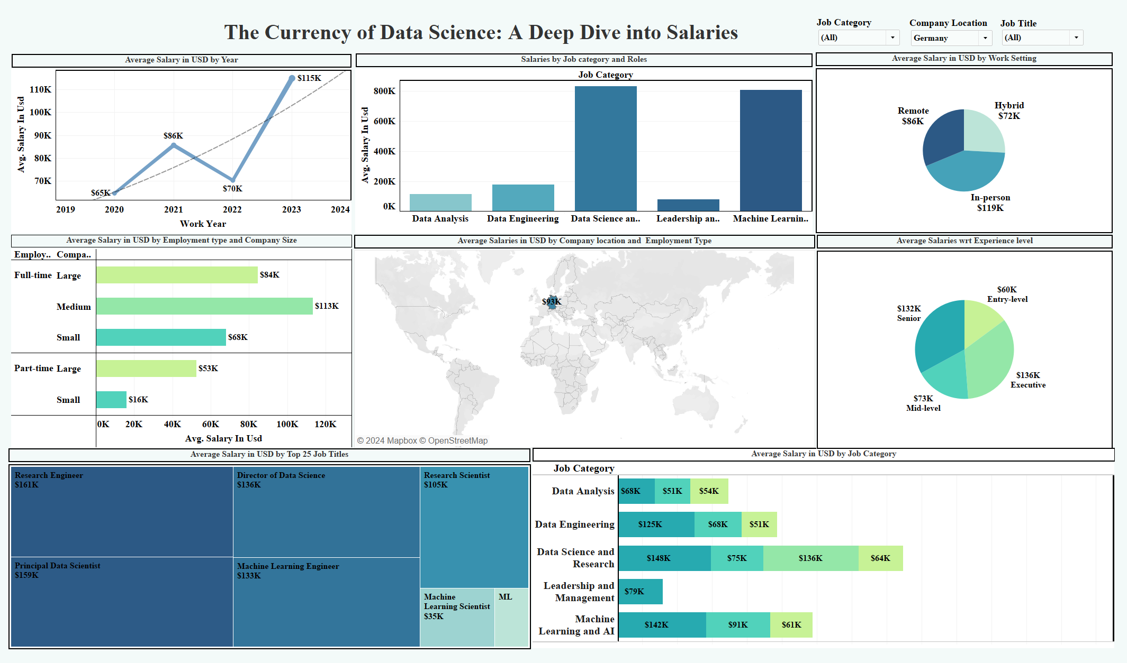


Slide 4
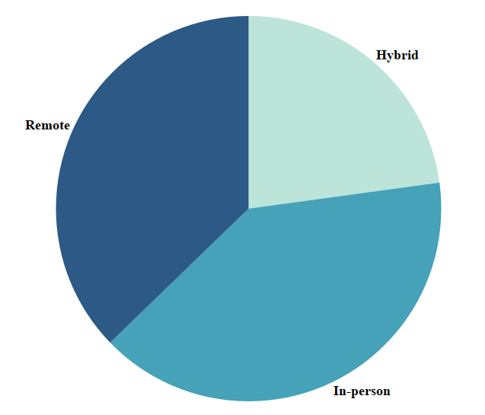
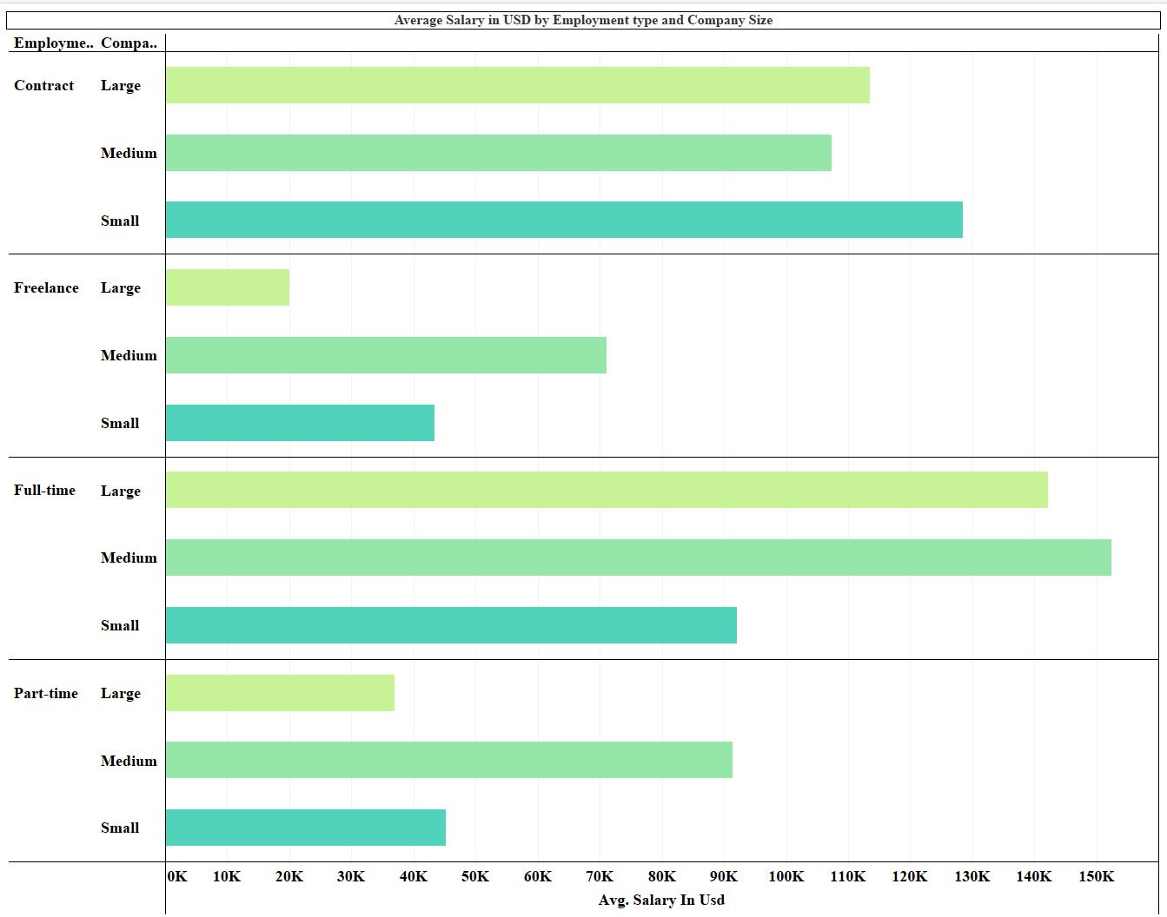

Patrick discovered that salaries varied based on work settings such as in-person, hybrid, or remote, and also depended on employment status - whether full-time, part-time, or freelance.
Using the dashboard's filters, he focused exclusively on roles aligning with his interests, like data analyst positions in the tech industry, facilitating a more efficient job search tailored to his preferences.

Slide 5

Armed with insights from the dashboard, Patrick embarked on a journey to enhance his skills, expand his network, and secure the ideal job.
Despite anticipating challenges along the way, he remained resolute in his determination to achieve success.
With every stride forward, he sensed himself edging closer to fulfilling his aspirations within the realm of data science.

